Slide 1
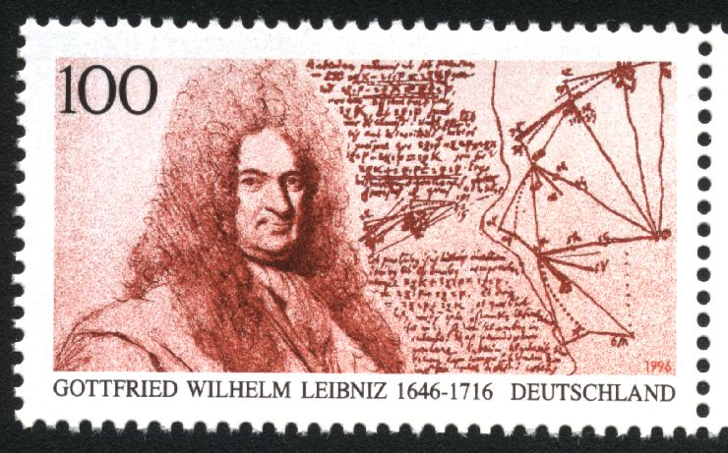
5.1 (cont.) Sums to Integrals
Greg Kelly, Hanford High School, Richland, Washington

Slide 2
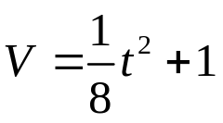

When we find the area under a curve by adding rectangles, the answer is called a Rieman sum.
The width of a rectangle is called a subinterval.
The entire interval is called the partition.
subinterval
partition
Subintervals do not all have to be the same size.

Slide 3
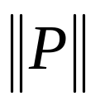
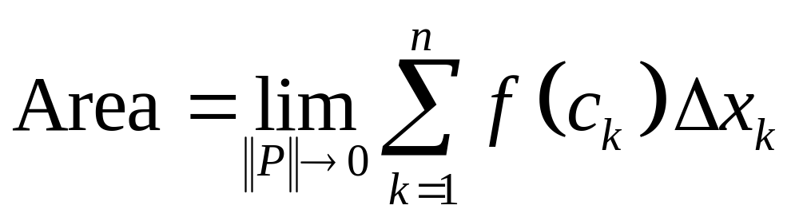
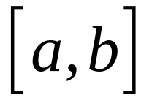
If the partition is denoted by P, then the length of the longest subinterval is called the norm of P and is denoted by .
subinterval
As gets smaller, the approximation for the area gets better.
partition
if P is a partition
of the interval

Slide 4
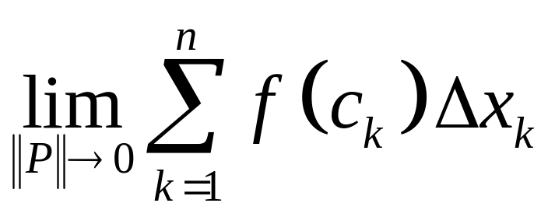
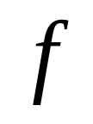
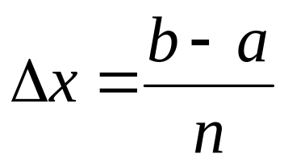
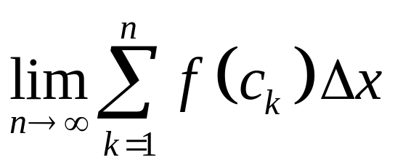
is called the definite integral of
over .
If we use subintervals of equal length, then the length of a subinterval is:
The definite integral is then given by:

Slide 5
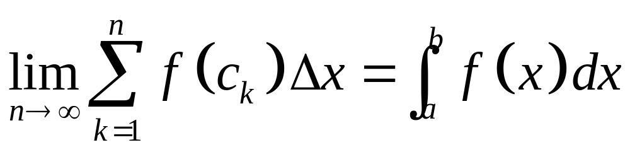
Leibnitz introduced a simpler notation for the definite integral:
Note that the very small change in x becomes dx.

Slide 6
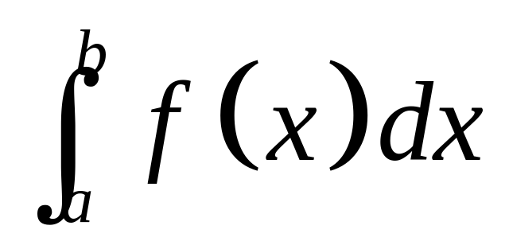
upper limit of integration
Integration
Symbol
integrand
variable of integration
(dummy variable)
lower limit of integration
It is called a dummy variable because the answer does not depend on the variable chosen.

Slide 7
We have the notation for integration, but we still need to learn how to evaluate the integral.

Slide 8
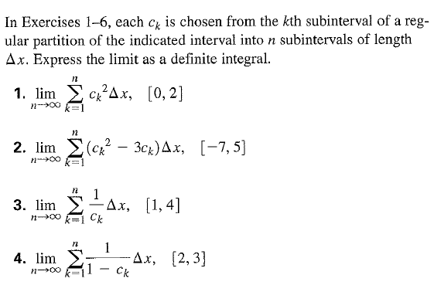
Now you try!
Change from Riemann sum notation to integral notation

Slide 9
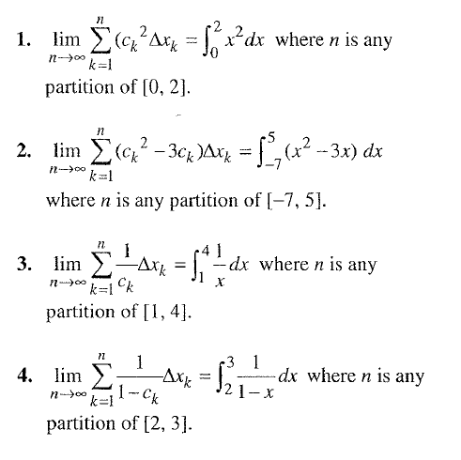

Slide 10
More Practice
If you want more practice changing sums to integrals watch the first ten minutes of this video:
http://www.chaoticgolf.com/vodcasts/calc/lesson5_2/lesson5_2.html

Slide 11
5.1 Approx. HW
Pg. 296 – 297: #6, #11 (graph/table: L,R,M)
Pg. 465: #105 (trapezoid)

